Slide 1
Introduction to Data Analytics
Day 4

Slide 2
Business Data Analytics Cycle
The business data analytics cycle represents the research aspects of business data analytics.
It is an iterative cycle initiated through the development of a well-formed research question and then explored through targeted, but thorough data analysis.
The scientific method is a process for research that is used to explore observations and answer questions.
The process starts by asking a question that scopes the research and is phrased as who, what, when, where, which, why or how.

Slide 3
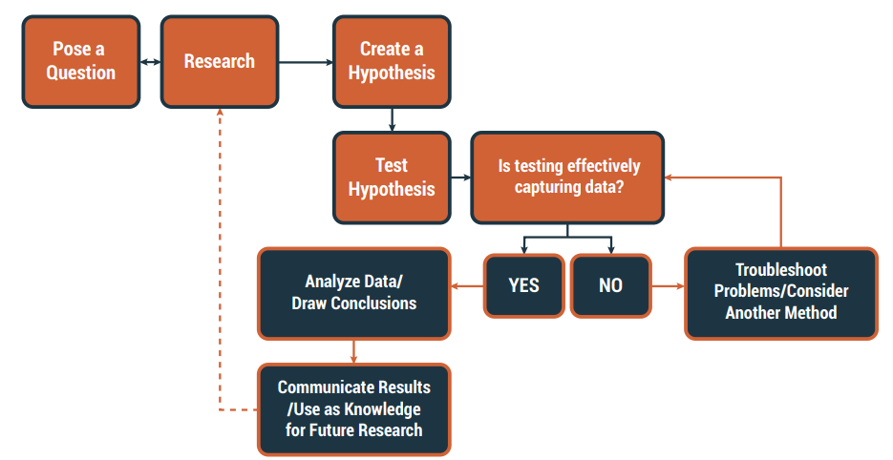
Business analytics process

Slide 4
Strategy for Business Data Analytics
Strategy for business data analytics includes the activities to build the capacity and capability for data analytics within an organization.
Strategy for Business Data Analytics includes:
• Building a Business Data Analytics Team
• Establishing Best Practices
• Curating Data
• Performing Data Management Functions
• Developing a Data Strategy
• Techniques

Slide 5
2. Establishing Best Practices
Establishing best practices in business data analytics involves identifying a standard set of tools and techniques that work well for the organization, for the types of problems being solved, and for the skill set and capabilities available.
3. Curating Data
Data curation involves the collection, aggregation, and integration of data from different sources. Early data curation processes focused heavily on obtaining data from transactional systems, but today's big data environments require more sophisticated tools and approaches to obtain data from a wide variety of sources

Slide 6
Performing Data Management Functions
Data management consists of the practices performed to administer data across an organization. Its major functions include:
Data governance: is the rules and policies that manage the data assets of an organization to ensure high-quality data.
Data architecture: is the models and standards that govern how data is collected, stored, and integrated across an enterprise.
Data security: are the activities performed to protect data from a privacy and confidentiality perspective. • Meta data management: is the administration of information that is maintained about the data assets an organization collects and manages

Slide 7
Challenges for Business Data Analytics
Business alignment and priorities from a data perspective can be difficult to define.
• Making decisions on topic, scale, or scope for a data initiative can be tricky.
• Determining which data to measure and capture to achieve business objectives can prove challenging.
• Finding data that creates value may be difficult; not all data helps make better decisions.
• Even when the data source is identified, defining the specific subset of data needed can be complex.
• Poor or unknown quality of data, especially historical

Slide 8
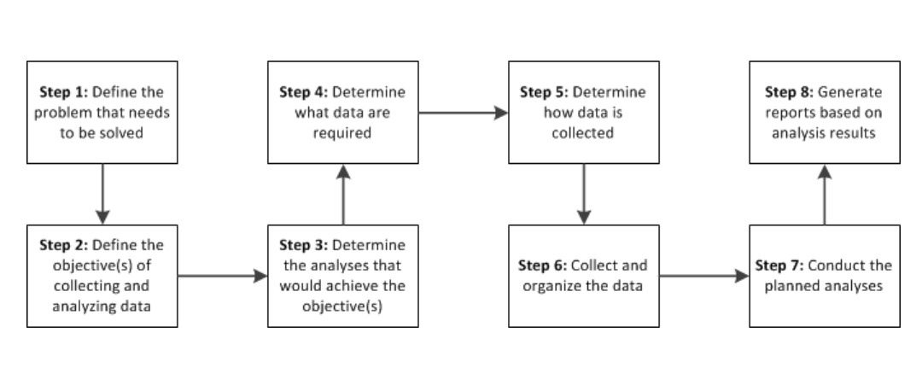
Process for collecting and analyzing data

Slide 9
Types of Data
1) Quantitative data – information that is collected
as, or can be translated into, numbers and which can
be displayed and analyzed mathematically.
• 2) Qualitative data – collected as descriptions,
anecdotes, opinions, interpretations, etc. and
generally cannot be reduced to numbers and left as
narratives

Slide 10
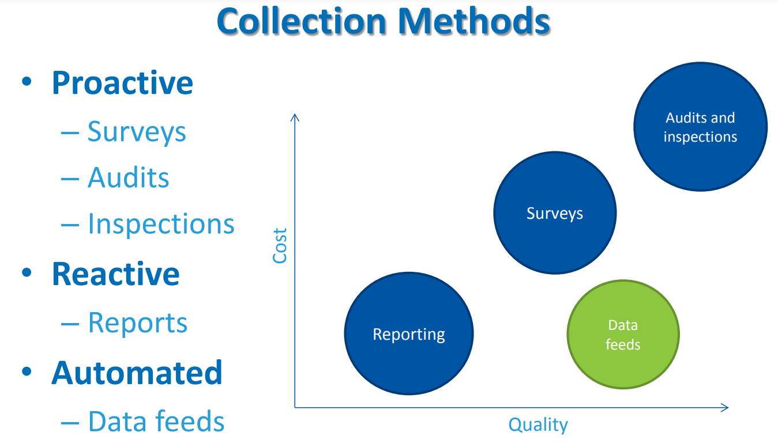
Data Collections

Slide 11
features of decision-making in data analytics:
1. Data-Driven Approach-Decision-making in data analytics is heavily reliant on empirical evidence and quantitative information. It involves analyzing data sets to identify trends, patterns, and correlations, which are then used to inform business strategies or operational changes. This approach minimizes reliance on intuition and gut feeling, instead emphasizing factual information.
2. Predictive Modeling- Data analytics often involves the use of predictive models. These models are built based on historical data and used to forecast future trends, outcomes, or events. This feature allows organizations to make proactive decisions, plan for contingencies, and optimize resource allocation.

Slide 12
features of decision-making in data analytics
Statistical Significance and Confidence Levels- Decisions in data analytics are typically guided by statistical significance and confidence levels. This involves quantifying the certainty or level of confidence associated with a particular finding or insight.
Iterative Process- Decision-making in data analytics is often an iterative process. Analysts refine models, experiment with different algorithms, and explore various data sources to improve the accuracy and relevance of their insights. This iterative nature allows for continuous refinement of decisions over time.

Slide 13
features of decision-making in data analytics
Consideration of Business Objectives-Effective data-driven decision-making aligns with the overall goals and objectives of the organization.
It's not just about finding interesting insights but about translating those insights into actions that contribute to the achievement of specific business objectives.
This requires a deep understanding of the organization's strategic priorities.

Slide 14
Data Visualization for Decision Making
Data visualization is the process of representing data or information using visual elements, such as graphs, charts, diagrams, and maps.
Data visualization for decision making aims to provide a clear and concise representation of data that viewers can easily understand.
Presenting data visually allows patterns and trends to be identified more quickly and easily, making it an effective tool for data analysis and communication.

Slide 15
How do we make decisions?
The average person makes 35,000 decisions per day. Before Big Data, people developed, adapted, and enhanced decision-making strategies.
According to research, humans make decisions by generating ideas and selecting actions through “mental processes influenced by biases, reason, emotions, and memories.”
While we strive to reach sensible, logical conclusions, many circumstances can hinder our decision-making.

Slide 16
Case study
Case Study: Choosing a Coffee Shop
Scenario: You are opening a new coffee shop in a busy downtown area. To attract customers and succeed, you need to make several important decisions: These are:
1.
2.

Slide 17
Coffee decisions
Location: Should you prioritize high foot traffic or a trendy neighborhood?
Menu: What type of coffee and food should you offer? Should you cater to specialty coffees or focus on affordability?
Pricing: How will you price your menu items to remain competitive and profitable?
Marketing: How will you reach your target audience and differentiate yourself from competitors?
Staffing: What type of staff should you hire to create a welcoming and efficient environment?

Slide 18
Traditional Decision-Making vs. Analytics Approach:
Before Big Data, you might rely on:
Intuition: Your gut feeling based on experience and limited information.
Market research: Surveys, focus groups, and competitor analysis.
Observation: Watching customer behavior in existing coffee shops

Slide 19
With analytics
Demographics: Analyze data on nearby residents, workers, and foot traffic patterns to identify your ideal customer base.
Transaction data: Analyze coffee shop purchase data to understand popular trends, price points, and spending habits.
Social media sentiment: Analyze online reviews and discussions to understand customer preferences and competitor strengths.
Location intelligence: Use data on nearby businesses, amenities, and transportation to assess the potential of different locations.

Slide 20
Common Data Quality Issues
Missing Values:
Data points that are empty or undefined.
Techniques for handling missing values:
Imputation (e.g., filling with mean, median, or mode).
Dropping rows or columns with too many missing values.
Duplicates:
Identical or repeated rows in the dataset.
Techniques for handling duplicates:
Removing duplicate rows.
Outliers:
Data points that deviate significantly from the rest of the data.
Techniques for handling outliers:
Winsorizing (capping extreme values).
Transformations (e.g., log transformation).

Slide 21
Data Cleaning Techniques
Handling Missing Values:
Imputation:
Mean Imputation: Replace missing values with the mean of the non-missing values in that column.
Median Imputation: Replace missing values with the median of the non-missing values in that column.
Mode Imputation: Replace missing categorical values with the mode.
Dropping Rows or Columns:
If a significant portion of the data is missing, it may be appropriate to drop the entire row or column.
Removing Duplicates:
Duplicate rows can skew analysis results. It's important to identify and remove them.

Slide 22
Data Cleaning Techniques
Handling Outliers:
Winsorizing:-Replacing extreme values with the nearest non-extreme value.
Transformations -Applying mathematical transformations (e.g., logarithmic transformation) to reduce the impact of outliers.

Slide 23
Case Study
A large retail chain, Ukwala, operates numerous stores across the country. The company wanted to improve the performance of its stores by optimizing various aspects of their operations, such as product placement, staffing levels, and marketing strategies.
Challenge:
Ukwala faced several challenges, including:
Inconsistent Sales Performance: Some stores consistently outperformed others, while some struggled to meet targets.
Inventory Management: There were instances of overstocking and understocking, leading to revenue loss and potential customer dissatisfaction.
Customer Behavior: Limited understanding of customer preferences and buying behavior, making it challenging to tailor marketing efforts effectively.
Staffing Levels: Determining the optimal number of staff required during different hours and days of the week.

Slide 24
Questions
Discuss and Recommend comprehensive data analytics solution to address these challenges.
Descriptive-
Diagnostic
Predictive
Prescriptive

Slide 25
END
Questions

